Slide 1


FINANCIAL AID
&
STUDENT ENROLLMENT SERVICES

Slide 2

FINANCIAL AID
In addition to implementing federal & state regulations for institutions, we serve three primary functions:
Evaluate a family’s ability to pay for educational costs
Distribute limited resources in an equitable manner
Provide a balance of gift and self-help aid where possible
Notes:
EDIT SLIDE

Slide 3

Applying for Financial Aid
Step 1: Create an FSA ID & Password
This is a Username & Electronic signature used to sign your FAFSA and
access www.studentaid.gov
In some cases, a Parent(s) OR Spouse may also be required to create an
FSAID & Password.
Step 2: Who should complete the FAFSA?
The 2024-2025 Free Application for Federal Student Aid (FAFSA) is required for a student to be considered for federal, state and some forms of institutional aid. This is inclusive of Direct Student loans, PLUS Loans and Private Education Loans. The application is open until June 30, 2025.
Notes:
https://studentaid.gov/fsa-id/create-account/launch

Slide 4
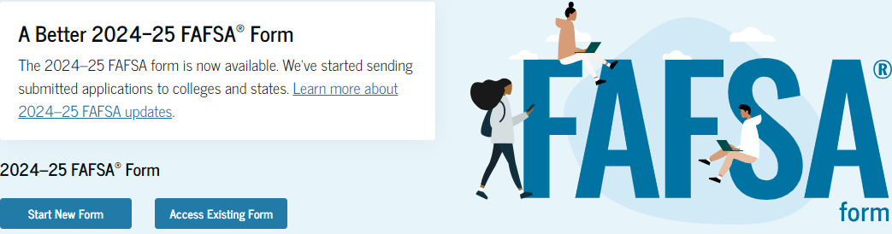
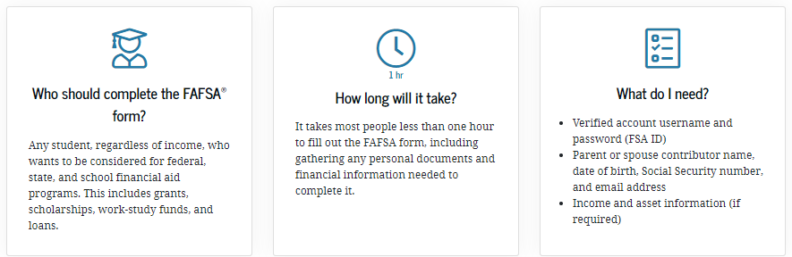
Applying for Financial Aid
Step 3: Filing a FAFSA
  1. A maximum of 46 questions in the application.
  2. Roles = Student (Applicant), Parent/Spouse, and Preparer. Once all required data has been provided and all sections have been signed, any role can submit the FAFSA form.
  3. Student’s and (where applicable)
  parent/spouse 2022 Federal tax information
  4. WPU school code number 002625
Notes:
https://studentaid.gov/fsa-id/create-account/launch
Once all required data has been provided and all sections have been signed, any role can submit the FAFSA form.

Slide 5
Verify My FAFSA http://wpunj.verifymyfafsa.com/
Verify My FAFSA is an online portal for submitting requested documentation to the Financial Aid Office.
Verify My FAFSA allows for you and your parent(s) (if you are a dependent student) to electronically sign (e-sign) your Financial Aid documents instead of having to print them out and sign them. In order to do this, you will need to set up a PIN number which will be used in place of your hardcopy signature on the documents.
Receive automated reminders about outstanding tasks and next steps

Slide 6
Verify my FAFSA, You’ll be able to:
Complete financial aid forms on your phone, tablet or computer
Securely upload documents from any device
E-Sign documents - for students and parents
Manage your financial aid tasks online
Receive automated reminders about outstanding tasks and next steps
Notes:
https://wpunj.verifymyfafsa.com/

Slide 7
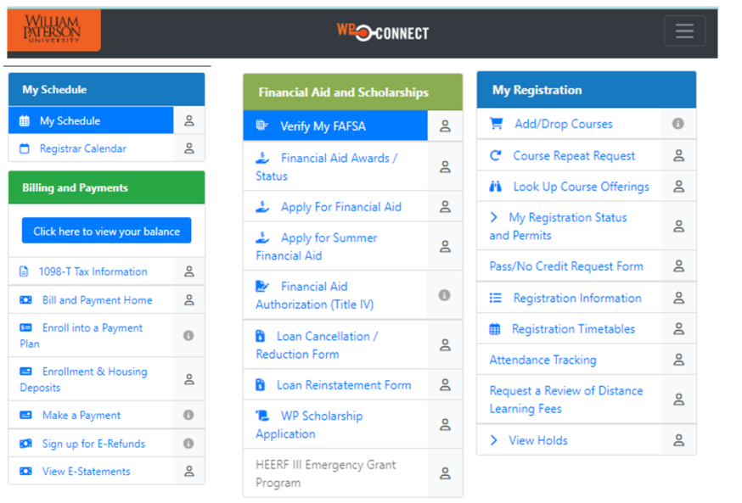
WPConnect Student Portal

Slide 8

Higher Education Student Assistance Authority (HESSA)
Additional Information Requests
Separate from federal regulations
May duplicate federal requests for information.
Students must respond directly to the state directly by completing/uploading requested documents online.
September 15th FAFSA filing deadline in your first year
April 15th** FAFSA filing deadline after first year
Notes:
June 1st this year only

Slide 9
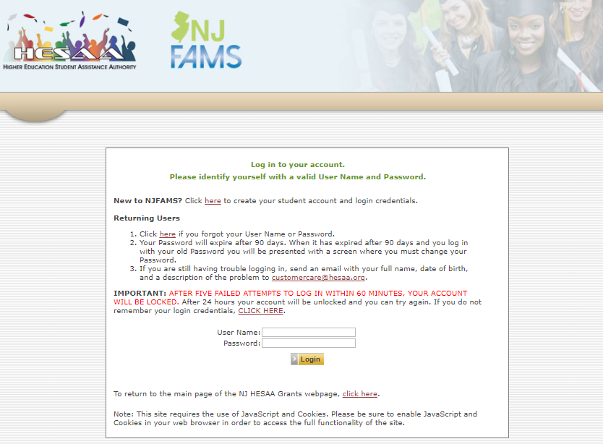
State Student Portal
https://njfams.hesaa.org

Slide 10
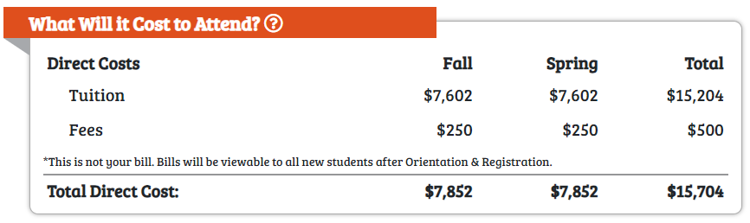
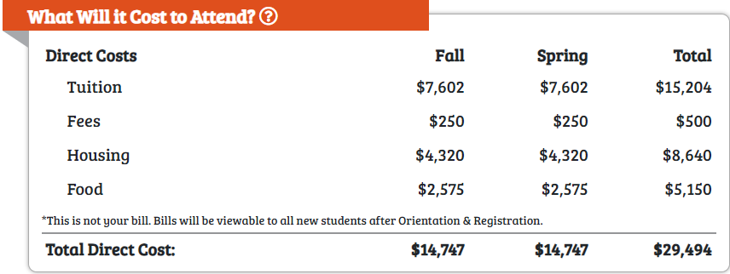
Direct vs Indirect Costs
Direct Costs: are those charges paid directly to William Paterson University. These include tuition, fees and room and board if you reside on campus.
Notes:
ADD OFFER LETTER SNIPPET**

Slide 11
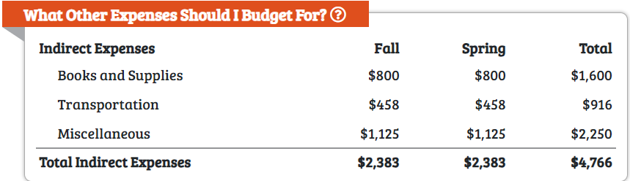
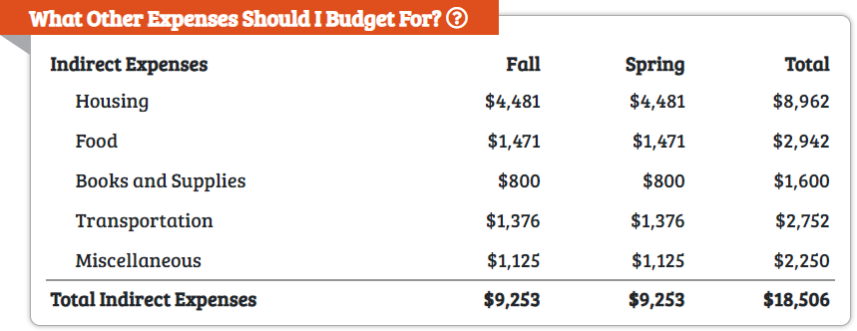
Direct vs Indirect Costs
Indirect Costs: are those costs you may incur while attending William Paterson University but not paid directly to the university (not billed to you). These include transportation to and from the university, miscellaneous expenses and room and board if you commute to campus or have your own independent off-campus housing .
Notes:
ADD OFFER LETTER SNIPPET**

Slide 12
TYPES OF AID
GRANTS:
Federal PELL Grant: eligibility determined by FAFSA.
Federal Supplemental Educational Opportunity Grant (FSEOG): for undergraduate students with exceptional financial need .
Federal Teacher Education Assistance for College & Higher Education (TEACH) Grant: for students enrolled in certain teaching education programs
NJ Tuition Aid Grant: eligibility determined by the FAFSA & NJ.
Institutional & External Scholarships:
Institutional Scholarships: Merit based scholarships awarded by admissions and/or other departments on campus (Honors college, Music Department, etc.).
https://www.wpunj.edu/admissions/undergraduate/scholarships/scholarshipsinstitutional.html
External/Private Scholarships: made available by external organizations and may be individually resourced by the parent or student. More information on additional scholarship opportunities is available at:
https://wpunj.edu/financial-aid/additional-scholarships/

Slide 13
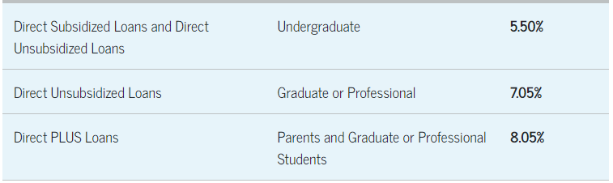
LOANS
Federal Subsidized & Unsubsidized Loans: eligibility determined by FAFSA & Institution.
Federal PLUS Loans: a credit based loan available to the parent(s) of dependent undergraduate students.
Private Education Loans: credits based loans offered from non-federal sources such as banks, credits unions, private education loan servicers, etc.

Slide 14

Federal Work Study
This program provides students with the opportunity to work up to 20 hrs/week during the academic year and 40 hours per week during breaks and holidays, if funds are available, and earn a paycheck.
Funds for this Federal program are extremely limited, students are awarded on a first-come, first-serve basis.
Students must attend a Student Employment Workshop to be considered for a Federal Work Study position. The dates of the workshops can be found on the Financial Aid home page under “Student Employment.”
Jobs are not guaranteed. Placement depends on student schedules, skills, Federal or departmental funding, student initiative and job availability.
Prior to starting employment, students must contact the Student Employment Coordinator in Financial Aid and submit additional application materials.
The current pay rate for work-study is $15.13/hr and $17/hr for Community Service positions.

Slide 15
Tuition-Free Opportunities
Pledge for Success
William Paterson University offers pathways to help qualifying New Jersey students with significant financial need to earn their bachelor’s degree at little to no cost—through the University’s own Pledge 4 Success program (for 1st and 2nd year students)
Pledge 4 Success: William Paterson’s Pledge 4 Success* program provides eligible first-year and sophomore students with the opportunity to earn a degree without having to worry about the cost of tuition and mandatory fees. For a student with a family adjusted gross income of $65,000 or less, the program covers the full cost of tuition and mandatory fees that are not already covered by other grants and/or scholarships
New Jersey students with family adjusted gross income between $65,001 to $80,000 can receive assistance so that their net cost for tuition and mandatory fees is no more than $7,500 annually.
Students will automatically be considered for both programs when they’ve completed the Free Application for Federal Student Aid (FAFSA) before the April 15th filing deadline (September 15th for first year students).

Slide 16

Garden State Guarantee
The program will provide up to four semesters of free tuition for New Jersey students in their third and fourth years whose family’s adjusted gross income (AGI) is between $0 and $65,000 annually.
New Jersey students in their third and fourth years with family adjusted gross income between $65,001 to $80,000 can receive assistance so that their net cost for tuition and fees is no more than $7,500 annually.
New Jersey students in their third and fourth years with family adjusted gross income between $80,001 to $100,000 can receive assistance so that their net cost for tuition and fees is no more than $10,000 annually.
Garden State Guarantee covers the cost of tuition and fees that are not already covered by other grants and/or scholarships awarded.

Slide 17
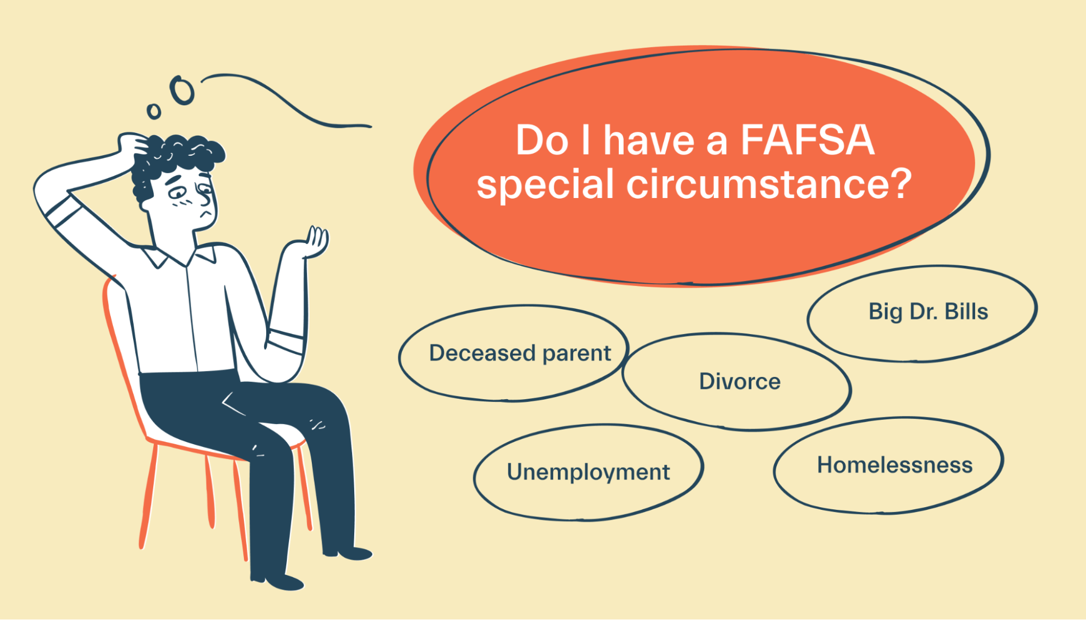
Special Circumstances
If you have had changes in your family financial situation after you have filed your FAFSA, you may want to submit a Special Conditions Request form, located on the Financial Aid website, under the “Forms” tab.
Filing and submitting this form with all appropriate documentation does not guarantee additional financial aid eligibility.
Special Circumstance examples are:
  Unemployment
  Disability
  Retirement
  Death
  Divorce or Separation
  Loss of Untaxed Income
  Loss if Unemployment Benefits
  Loss of Full-Time Work
  Unreimbursed Paid Medical Expenses
Will.Power

Slide 18

Satisfactory Academic Policy
To be eligible for federal and state student aid funds a student must be
making satisfactory academic progress.
Three criteria used for evaluating SAP:
1.Grade Point Average – GPA:
2.0 or better GPA required
2.Completion Rate:
Must complete 67% of attempted credits
3.Maximum Credits Attempted – Maximum Time Frame
150% of degree credits required for degree =maximum of 180 credits

Slide 19
Tips for Maintaining SAP
See your Academic Advisor regularly
Review your WPConnect/DegreeWorks as frequently as you can to ensure you are on track and completing required course curriculum.
Focus on your degree/graduation requirements by taking only courses that pertain to your degree while also completing your general electives
Educate yourself on SAP criteria by regularly visiting the Financial Aid Services web page on the WPU website and by meeting with your FA Advisor.

Slide 20
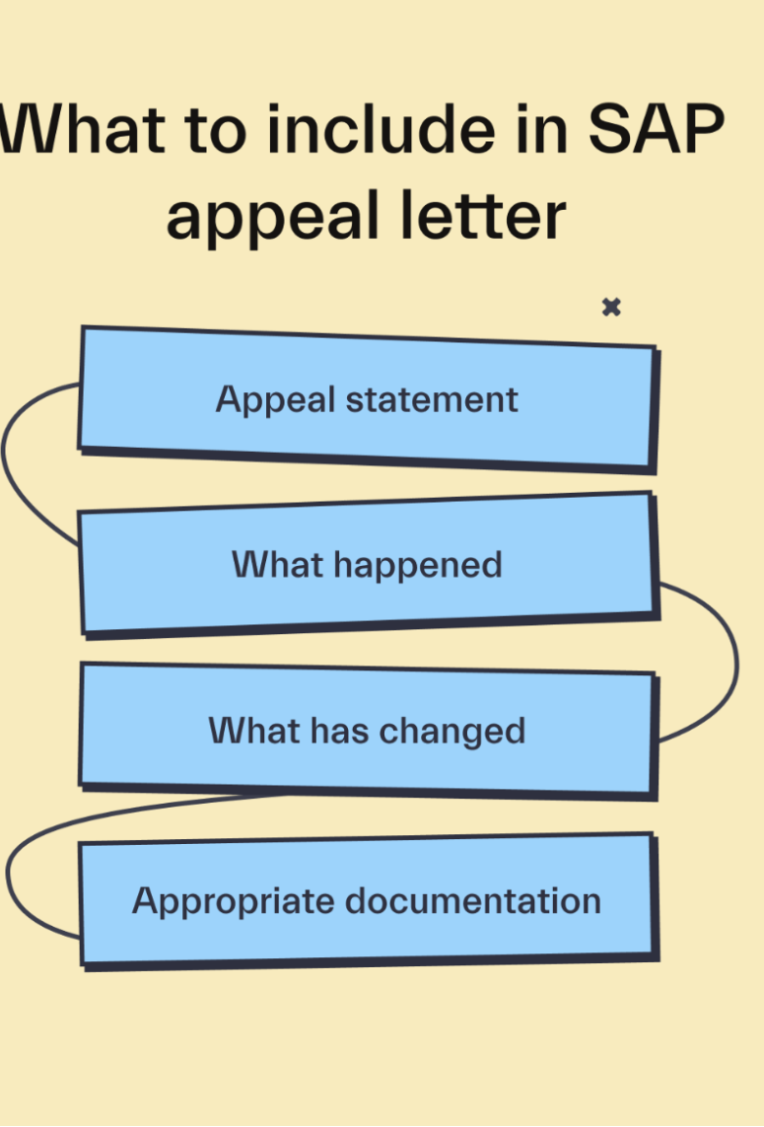
SAP Appeal
Evaluation of student academic performance occurs annually at the end of the spring semester. Students identified as not making SAP will receive correspondence at their campus e-mail address in the month of June.
Students not making SAP at the end of the spring semester are not eligible for summer financial aid.
Students have the right to appeal the decision by submitting an online appeal. Generally, the SAP Appeals Committee will consider appeals that involve circumstances beyond the student’s control that have had an impact upon the student’s academic performance.
A committee will review the appeal and a response will be provided within fifteen (15) business days. Students will be notified of the committee’s decision in writing (personal email announcement at their WPU Connect account). The decision of the SAP Appeals Committee is final.

Slide 21


Financial Aid
Stacy-Ann Brown, Director
Stella James, Sr. Associate Director
Morrison Hall 101
Phone: (973) 720-3945
Email: finaid@wpunj.edu
www.wpunj.edu/finaid

Slide 22
STUDENT ENROLLMENT SERVICES

Slide 23

STUDENT ENROLLMENT SERVICES
Financial Aid
Status of Awards
Submit Documentation
Status of disbursements
Render Payments
Balance Inquiries
Payment Plan Options
Billing/Payment
Verifications
Transcripts
Records
Form completion
Status of refunds

Slide 24

Understanding Registration/Bills
Fall: Registration in March
Payment due early-August
Spring: Registration in October
Bills generated in July
Bills generated in late November
Payment due early January

Slide 25

Fall 2024 and Spring 2025
Tuition and Fees –Main Campus
Flat rate between 12-19 credits
Full Time UG In State
Full Time UG Out of State*
$7,852.00 per semester
$12,672.00 per semester*
*Out of State Waiver scholarship reduces cost to In-State Rates
Out-of-State Waiver Scholarship: Must meet minimum criteria to qualify
The rate for registration in excess of 19 credits is estimated at $503.90 per credit for NJ in state rates.

Slide 26
Fall 2024 & Spring 2025 Average Room/Meal Rates
Per semester
Double Room (varied according to hall)
Apt/Suite: $4,970.00
9 Month $5,300.00
Skyline
$4,710.00
Meal Plan Avg. (15 meals + $400.00 cash)
$2,705.00
$4,320.00- $4,450.00
Single rooms available at an additional cost

Slide 27
WPConnect Student Portal

Slide 28
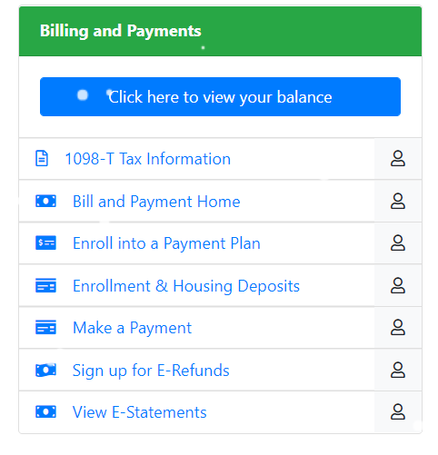
Understanding Registration/Bills
Viewing your bill
  Charges
  Payments
  Amount Due
  Payment Due Date
  Health Insurance- waive
    www.wpunj.edu/studentaccounts

Slide 29

Authorized Users
Students can authorize a parent or third party direct access
to view their E-statement
Does not provide access to grades or other confidential information
Authorized users receive their own access with a unique username/password
Provides Access to:
1098T tax statements
E-statements and make payments
Enroll in TIP plans

Slide 30
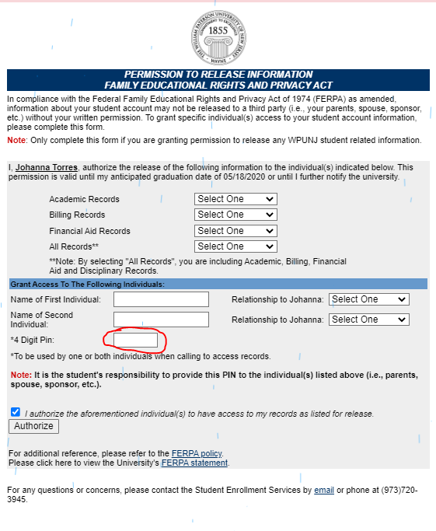
FERPA
After the 1st day of classes
Student have to provide us with permission to discuss information about their account with a 3rd party.
Form On WPConnect:
Academic
Financial Aid
All of the above- includes Disciplinary Records
Billing

Slide 31


Student Health Insurance
Students will automatically be enrolled (and billed)
for Student Health Insurance, Fall $2,704.00.
If a student has health insurance coverage, a waiver application must be completed before the deadline:
Health Insurance information, waiver application and deadlines will be available on the Student Accounts website:
www.wpunj.edu/studentaccounts
Fall 2024: September 27, 2024

Slide 32

Payment Options
Cash:
Check/Money Order:
In-Person at Student Enrollment Services, Morrison Hall
Mail to Lockbox at WPUNJ, PO Box 60051, Newark, NJ 07101-8084 address or
Accepted in person at Student Enrollment Services, Morrison Hall
Important:
Student’s ID number must be on all check payments

Slide 33
Online Payment Options
Payments can be made Online
E-Checks
Free:
Via WP Connect Student portal
Credit and Debit Cards:
Visa, MasterCard, Amex and Discover
The cardholder will be charged a convenience fee of 2.95%
Billing and Payment link
There are NO additional fees charged for payments by e-check.

Slide 34

3rd Party Payments & Scholarships
Outside Scholarships:
529 College Savings Plan:
Check made payable to student only: Student may cash
Third Party Payment/ Company Sponsorship:
Check made payable to WPU: Bring to SES
*All checks must include student I.D. number
Check made payable to both WPU & Student: Student endorse check and bring to SES.
Need initial “Letter of Credit” on company letterhead, from department with contact information.
The account holder needs to contact their 529 plan provide to establish criteria for disbursement

Slide 35

Tuition Installment Plans (TIP)
Interest free monthly installment plans
Fall and/or Spring semester educational expenses spread over equal monthly installments
Fall
Spring
5 month TIP starts in July
4 month TIP starts in August
5 month TIP starts in December
4 month TIP starts in January
We are here for you!
Visit SES if you require an Alternative Payment Option.
* No interest fees. Only a $25.00 TIP enrollment fee is charged, per semester

Slide 36

University Records
Official Transcripts
Enrollment Verifications
Free
Paper-Processed next Business day
Also available through WP Connect, linking to the National Student Clearinghouse
Electronic transcripts- Same day
$10.00 fee

Slide 37
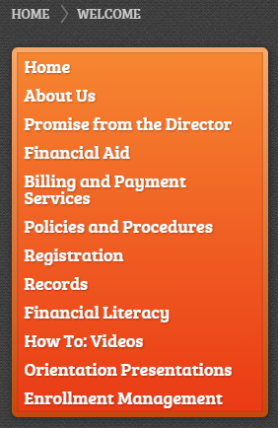
Student Enrollment Services
Questions?
Contact us!
Johanna Torres, Director
Dayana Nunez, Associate Director
Joan Baguidy, Assistant Director
Morrison Hall 100/104
Phone: (973) 720-3945
Email: studentservices@wpunj.edu
www.wpunj.edu/centerss

